Slide 1
Project 2
College Graduate Earnings
Math 2327 - Instruction to Data Analysis
Giovanni Miquelin, Miranda Hancock, Khadeja Monshin

Slide 2
01
Understanding
Meeting the DataSet

Slide 3

Contents
01
Earnings
02
Debts
General Student information:
General Debt Information:
Median Earnings after graduation
Median Earnings post graduation
Projection 2034
National Earning Median
Debt to earnings (ROI)
Debt amount
Loans
Privacy Status

Slide 4

Contents
03
Institutions
04
AI Tools
General University Informations:
General AI Information:
Location and Name
Admission Information
Tuition Prices
Majors
AI Adoption by Occupation
Daily Tool Usage
Career Path Exposure Percentage
Technical Skill Requirements

Slide 5

DataSet Challenges
01
Formatting
02
Missing Data
03
Data Scale
Variable Names & Format
Inconsistent and Confusing Var Names.
Fix wrong or weird variable formatting
Multiple NULL Values
Identify whether NULL signifies
Filter out NULL entries so they don't skew statistical equations.
Excessive Row Count
Too many rows hinder adding and rendering graphs normally.
It crashed my Tableau :(

Slide 6


Examples:

Slide 7
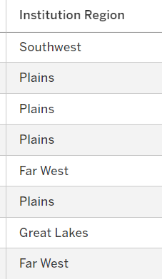
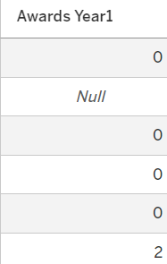
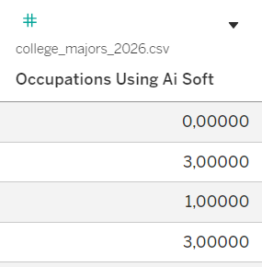
Examples:

Slide 8
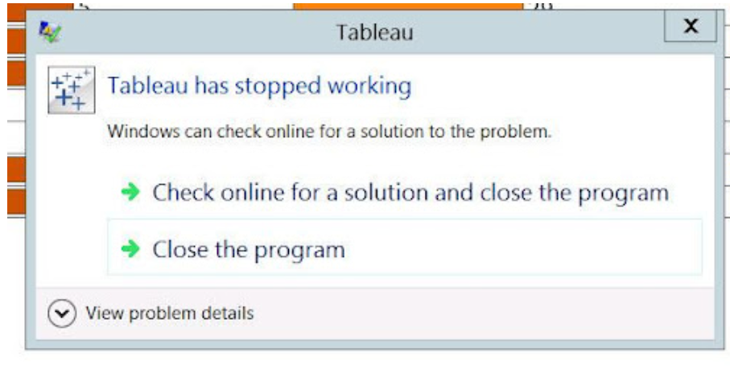
Examples:

Slide 9

What is this about?
227,980 U.S. College Programs
One row for every institution × field of study × credential level.
QUESTION
What is the most “Optimal path”
a student can take? The most Risky?

Slide 10
What is this about?
Simple Question?
No, it’s not
Relying solely on overall salary averages obscures key financial realities.
Salary Averages: Important! But not all.
Debt Load Variations: Student debt levels differ drastically across institutions.
Industry Trajectory: High earnings in shrinking fields carry distinct long-term risks.

Slide 11
But First…..
How does an Average Student looks like?
Time to meet John…

Slide 12

The “Perfectly Average Student”
Major: Business (Public) - Bachelors
Debt to Earnings (1y)
60,8%
Median Student Debt
$29,500
Avg Entry-Level (Yr 1)
$~54,000 / yr
Avg Mid-Career (Yr 5)
$~88,000 / yr
Avg Career Growth
8.31%
Likelihood of remaining employed
62%

Slide 13
02
The Bet vs the Biggest Gamble
Let’s talk money

Slide 14

High Pay, Low Pain
1-Yr Avg. Earnings
Avg. Total Debt
$127,920
$134,005
$130,992
$97,586
$77,695
$83,023
Computer Science
Electrical Engineering
Pharmacy
Key Finding:
1-Year earnings cover 60%–75% of total debt in year one

Slide 15
High Pain, Low Gain
1-Yr Avg. Earnings
Avg. Total Debt
$79,302
$80,190
$76,473
$23,682
$26,175
$22,182
Dance
Performing Arts, Other
Theatre Arts & Stagecraft
Key Finding:
1-Year earnings cover less than 33% of total debt across

Slide 16

Job Growth Benchmarks
Above Average
Below Average
> 15%
< 5%
High Demand: Strong expansion potential
Stagnant Output: Declining industry demand
•
Strategic Fit: Requires competitive advantage
•
High Competition: Slower long-term growth

Slide 17
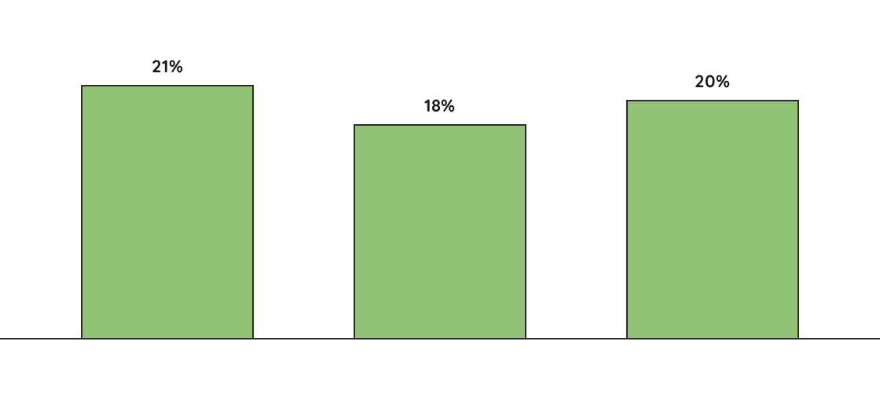
Top 3 Majors for Growth
Mathematics and Statistics, Other
Public Policy Analysis
Statistics

Slide 18
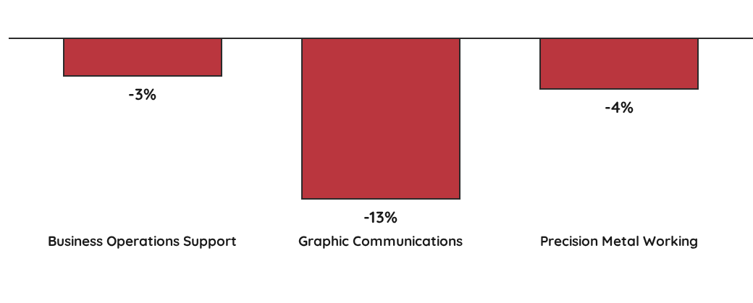
Bottom 3 Majors for Growth

Slide 19
Debt-to-Earnings Ratio Analysis
Computer Science
Electrical Engineering
Pharmacy
1-Yr Debt
4-Yr Debt
1-Yr Debt
4-Yr Debt
1-Yr Debt
4-Yr Debt
32%
22%
29%
22%
141%
93%
High initial debt; 48% drop by Yr 4.
10% debt drop by Year 4.
Matches CS at 22% benchmark.
Main Observation: Pharmacy graduates face roughly 4x higher debt burden than engineering majors

Slide 20
1-Year vs. 4-Year Debt Trajectory
1yr Debt to Earnings
4yr Debt to Earnings
141%
93%
32%
29%
22%
22%
Computer Science
Electrical Engineering
Pharmacy

Slide 21
Debt-to-Earnings Ratio Analysis
Dance
Performing Arts
Theatre & Stagecraft
1-Yr Debt
4-Yr Debt
1-Yr Debt
4-Yr Debt
1-Yr Debt
4-Yr Debt
117%
61%
120%
65%
128%
66%
56% debt reduction by Year 4.
55% debt drop over 4 years.
Highest initial debt at 128%.
Main Observation: All cut their debt-to-earnings burden nearly in half by Year 4.

Slide 22
1-Year vs. 4-Year Debt Trajectory
1yr Debt to Earnings
4yr Debt to Earnings
128%
117%
120%
61%
65%
66%
Dance
Performing Arts, Other
Theatre & Stagecraft

Slide 23
03
The Long Game: How Earnings, Careers & AI Evolve After Graduation
Choosing a major isn't just about the first paycheck.

Slide 24
Earnings growth: do winners keep winning?
Career outlook: which fields grow to 2034?
AI: does tech adoption track opportunity?
Choosing a major isn't just about the first paycheck.

Slide 25
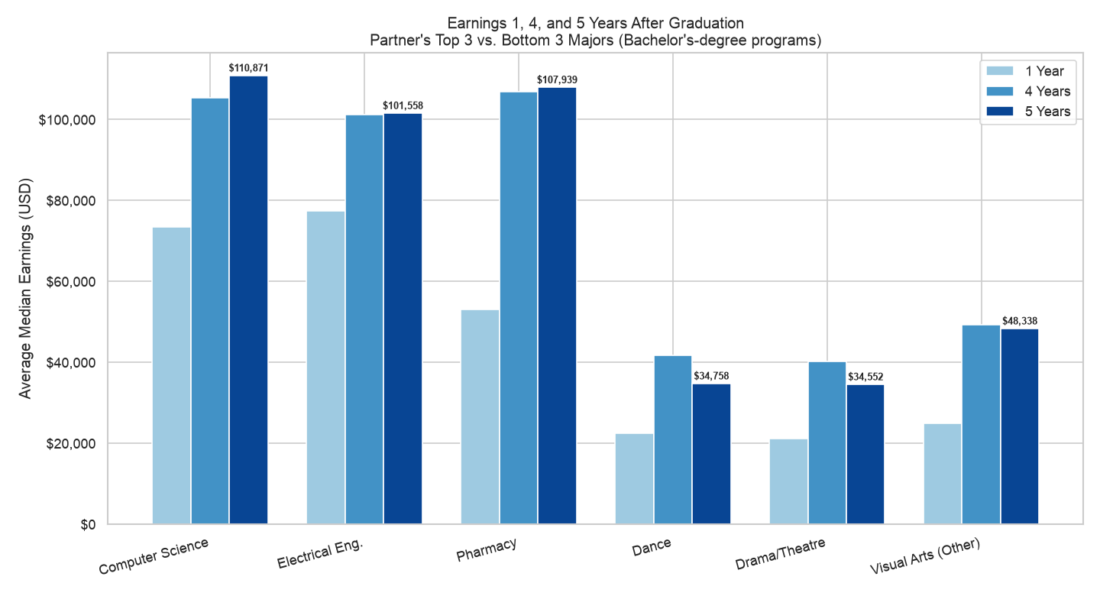

Slide 26
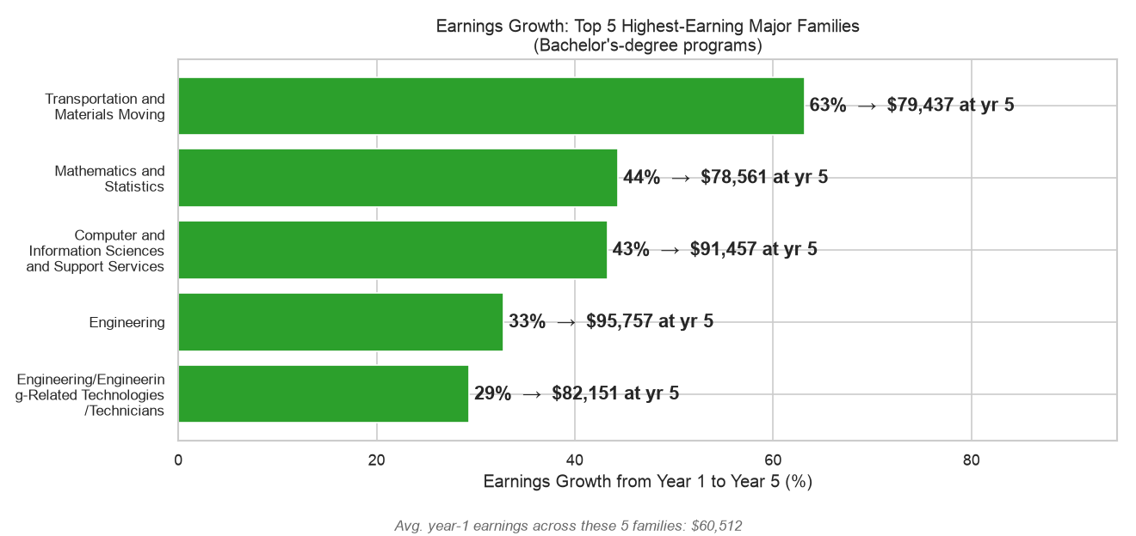

Slide 27
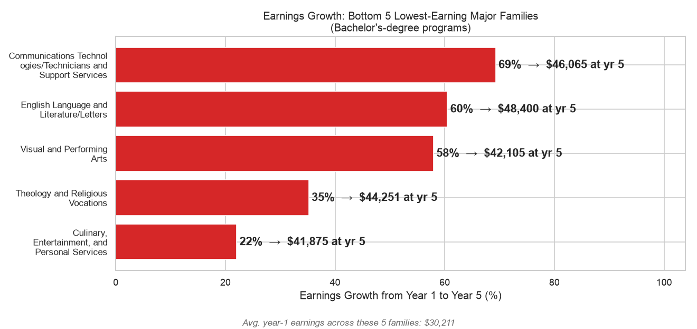

Slide 28
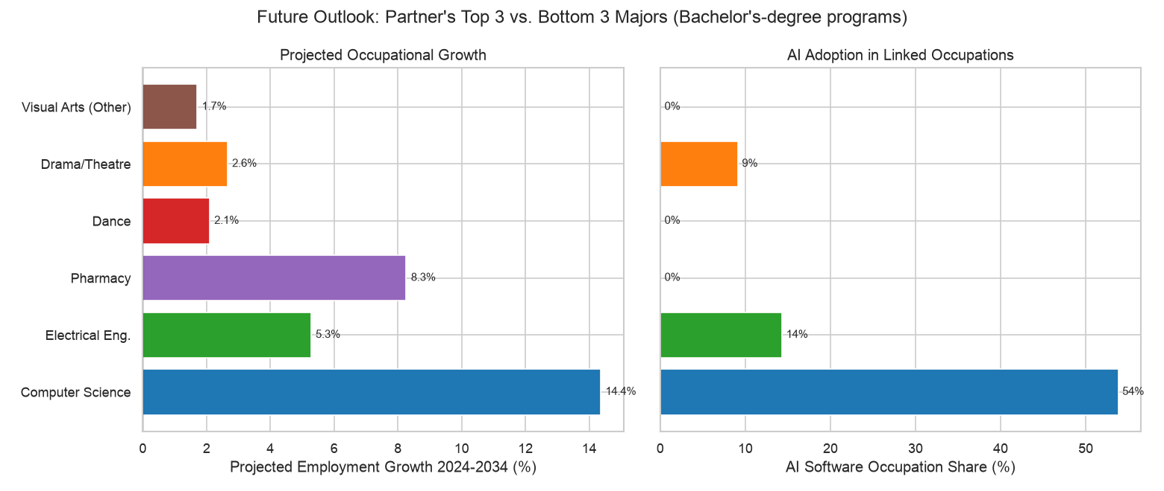

Slide 29
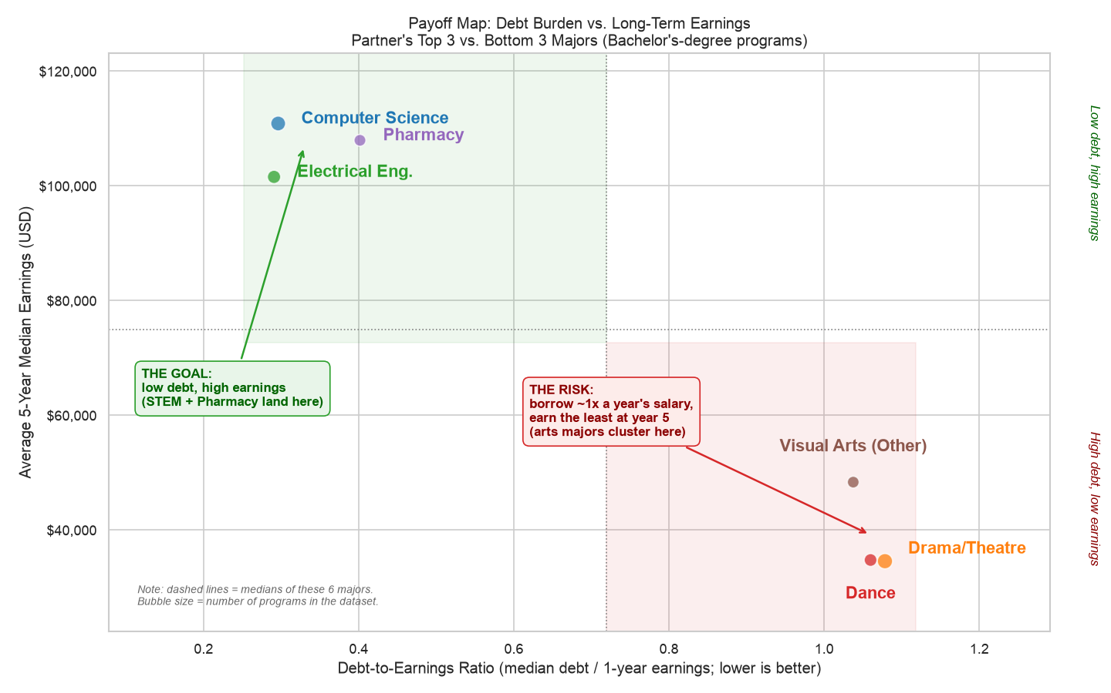

Slide 30
04
Conclusion
The Final Verdict

Slide 31
THE ANSWER
trending_up
OPTIMAL PATHS
warning
HIGH-RISK PATHS
STEM Fields
Performing Arts/Comms
PROFILE
High Entry Pay
Growing Field
Low Avg. Automation Risk
Low Debt-to-Earning Ratio
PROFILE
Low Entry and Future Pay
Stagnant Field (No growth)
No Automation Profile
High Early Debt-to-Earnings Ratio
DATA POINT
Computer Science offers $77k–$83k entry pay with 22% 4-year debt ratios.
DATA POINT
Dance & Theatre starting pay ($22k–$26k) leaves 1-year debt exceeding 117%.

Slide 32
THE TRAP
warning
HIGH SALARY TRAP
Great Earnings Illusion (Pharmacy Example)
STARTING SALARY
LATE DEBT BURDEN
INDUSTRY GROWTH
$97.5k
141% | 93%
< 5%
False sense of financial security.
Offsets high starting compensation.
Limits long-term advancement and salary trajectory.

Slide 33
"Data gives you the map, but your ambition determines the destination"
balance
auto_awesome
DECISION FRAMEWORK
Balanced Evaluation
True value requires balancing upfront debt, career growth, and market trends.
HUMAN FACTORS
Beyond the Data
Luck, connections, and hard work should never be forgotten.

Slide 34
Thanks for Watching
Please feel free to ask any questions

